Slide 1
Task Management System for
Efficient Work Organization
Presented by:-
1. Name- Ramane Ritesh Jaywant
PRN - 23UET099
2. Name- Nandre Pranali Jingonda
PRN - 23UET074
Under Guidance of
Dr. J.P. Kharat

Slide 2
Introduction & Problem Statement
Introduction
Problem Statement
Task management is critical for individuals and teams to stay productive and organized. Traditional to-do lists are often disconnected — no stats, no filtering, no persistence. This project builds a Python Task Manager with full CRUD operations, priority levels, and status tracking. A beautiful web dashboard provides real-time visual insights alongside a CLI program.
Professionals and students face challenges in:
Keeping track of tasks across priority levels
Monitoring completion progress without visual tools
Filtering tasks by status or urgency quickly
Persisting tasks reliably between sessions
Goal: Build a binary classifier task system with CLI + Web Dashboard using structured Python code.

Slide 3
Project Objectives
Add, Edit, Delete, and View tasks with title, description, priority, status, and due date
Implement Priority levels (High / Medium / Low) and Status tracking (Pending / In Progress / Done)
Persist all task data to a JSON file for reliable storage between sessions
Provide a CLI menu-driven program for full task management from the terminal
Build a web dashboard with live stats, progress bar, and filter by status or priority
Show visual indicators for overdue tasks, completion rate, and high-priority items
Ensure clean, modular code with a reusable TaskManager library (todo.py)

Slide 4
Core Modules
1
todo.py — Core Library: Task and TaskManager classes with Priority/Status enums. Handles all CRUD operations and JSON persistence.
2
main.py — CLI Program: Menu-driven command-line interface. Supports add, edit, delete, filter, status update, and stats display.
3
dashboard.html — Web Dashboard: Browser-based UI with live stats cards, progress bar, sidebar navigation, and modal for adding/editing tasks.
4
JSON Storage Module: tasks.json stores all task data. Auto-created on first run. load() and save() methods keep data persistent.
5
Filter & Stats Module: get_all(status_filter, priority_filter) and get_stats() provide filtered views and completion metrics.

Slide 5
Program Workflow
START
User runs main.py (CLI) or opens dashboard.html (Web)
▼
LOAD
TaskManager loads tasks.json into memory
▼
INPUT
User selects action: Add / Edit / Delete / View / Filter
▼
PROCESS
Core logic runs: CRUD, priority set, status update, JSON save
▼
OUTPUT
CLI prints table or Dashboard updates stats + task list
▼
LOOP
Return to menu — session continues until user exits

Slide 6
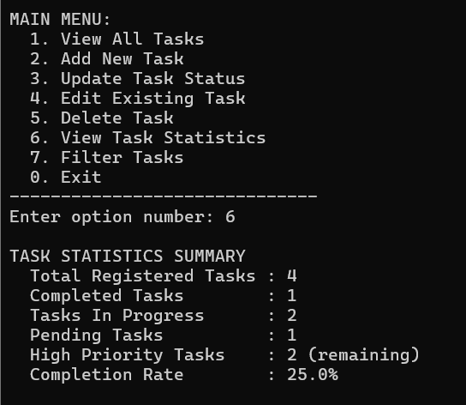
Program Output — Dashboard & CLI
Web Dashboard Output
Terminal Output
TaskFlow
Dashboard
+ New Task
All Tasks
6
1
2
3
Total
Done
Active
High
Pending
In Progress
Overall Progress
17%
Completed
TASK
PRIORITY
STATUS
High Priority
Design architecture
HIGH
IN PROGRESS
Set up repository
HIGH
DONE
Write unit tests
MEDIUM
PENDING
Update documentation
LOW
PENDING
Fix payment bug
HIGH
PENDING

Slide 7
Conclusion
This project built a complete Python Task Manager with two interfaces:
a CLI program for terminal users and a web dashboard for visual tracking.
It demonstrates OOP design, JSON file persistence, priority and status management,
real-time filtering, and a clean professional dashboard UI.
The modular structure (todo.py / main.py / dashboard.html) makes it easy
to extend with features like deadlines, categories, or cloud sync.
Thank You!

